Slide 1
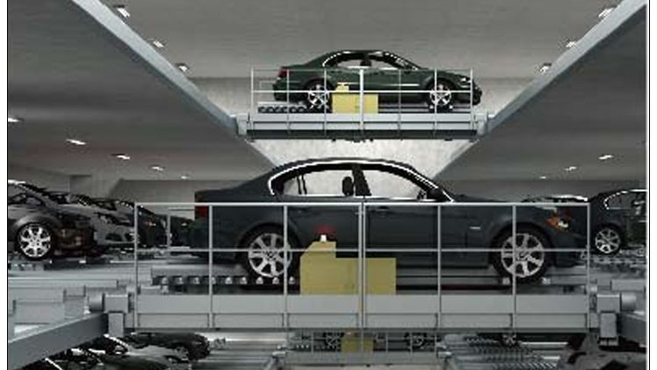

Maya-Nrutya
This Photo by Unknown author is licensed under CC BY.

Slide 2



Tagline
From Lost in lots to one-click spots, Let our AI robots parks your car and save your time

Slide 3
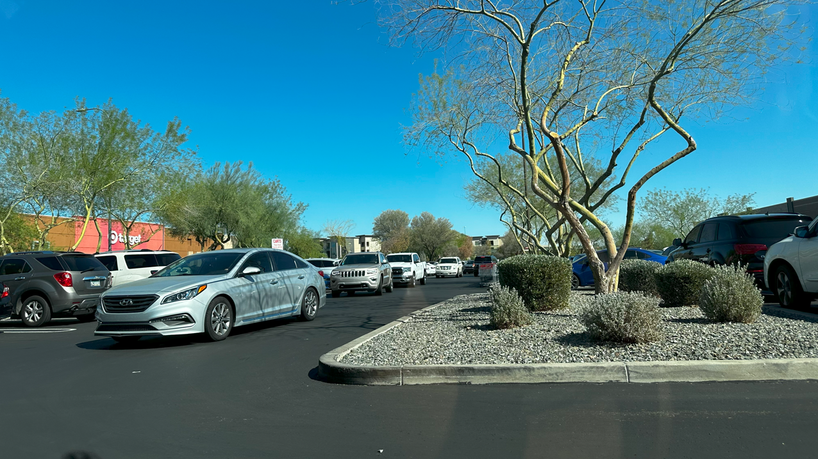
Problem
Finding a Parking Spot in malls and stores is a hectic task for customers
It's more difficult to find where the car is parked
Difficulty adds up when customers purchases increase

Slide 4
Solution
Our Robot “Tumba” lifts up the vehicle and parks it in available parking spots
The available parking spots are updated to the robots
A centralized system managed by a supervisor

Slide 5
Market Size

Slide 6
Business Model
Monthly Pass:
30$ per month in malls and Retail Stores

Slide 7
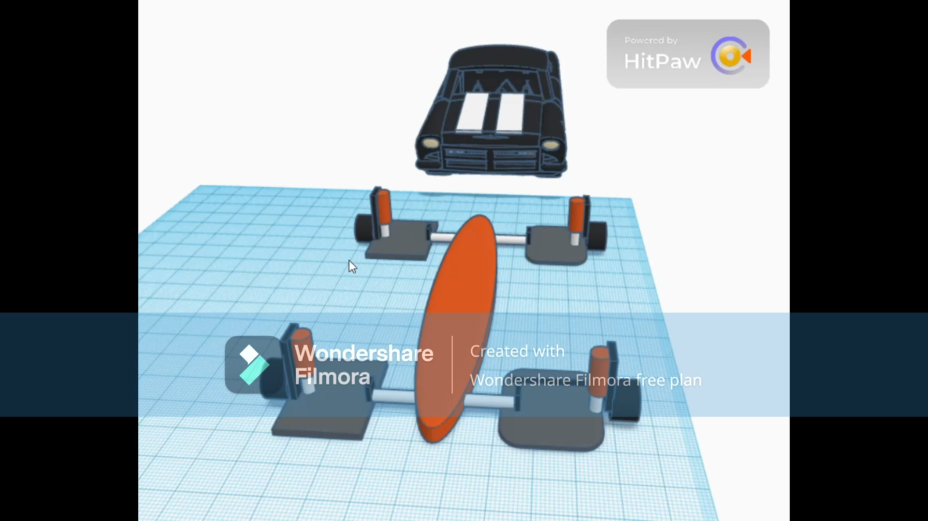
Product

Slide 8
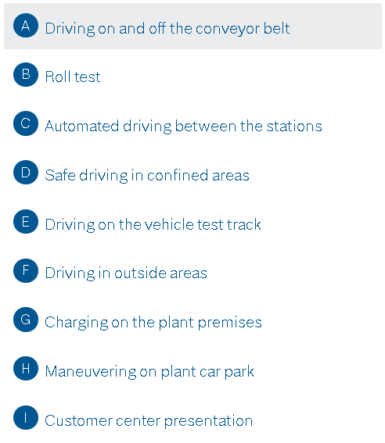
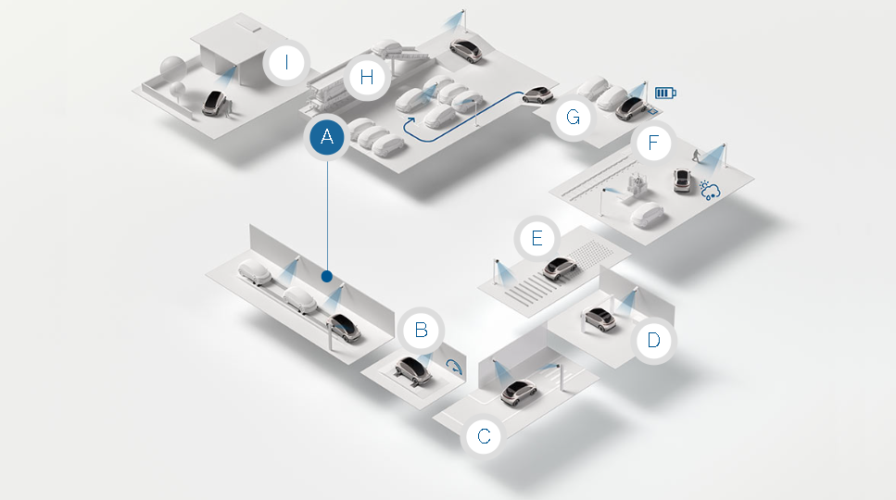
Competitors : Bosch
Resource : https://www.bosch-mobility.com/en/solutions/parking/automated-valet-parking/

Slide 9
Competitive Advantages
No need for dedicated spaces for parking
Not dependent on the advanced car systems
Works on any type of Vehicle
Easy pick up and drops of vehicles

Slide 10
Traction
Q3 2023
Designing Solutions and more problems
Q4 2023 – Q2 2024
Funding for prototype development
Q1 – Q3 2024
Development of prototype and recruitment
Q4 2024
Preliminary testing
Q1 – Q3 2025
Final testing and development
Q4 2025
Product launch

Slide 11



Our Team
Yashaswi Ranga Sivaraju
Vishwas Gopala Krishna
Akshay Fulzele
C.E.O. and Founder
C.T.O. and Founder
C.F.O. and Co-Founder

